Slide 1
Just Pick – movie recommendation
Sprint 9

Slide 2
Progress:
Semantic search bar
Posters

Slide 3
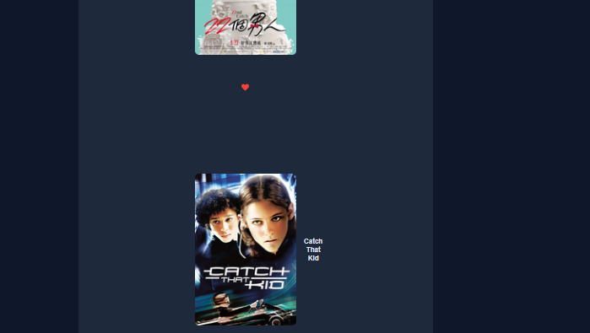

Slide 4
Next steps:
Correct style
Refactor Prompt

Slide 5
Thank you
Presented by:
Julia, Martin, Matthew

